Slide 1
Lecture 13: Environmental Justice History and Context
Prof. Austin
Environmental Economics Econ 4075

Slide 2
Environmental Justice Roadmap
The next two lectures we will focus on two big questions:
Why is there inequality of pollution exposure for minority and low-income populations?
Contextual background, common explanations
How can we determine if environmental policies will worsen environmental or wealth inequality for minority and low-income populations?
Framework for EJ analysis of regulations, analytic considerations, prospective analyses, retrospective studies

Slide 3
Part 1: Environmental Justice Background

Slide 4
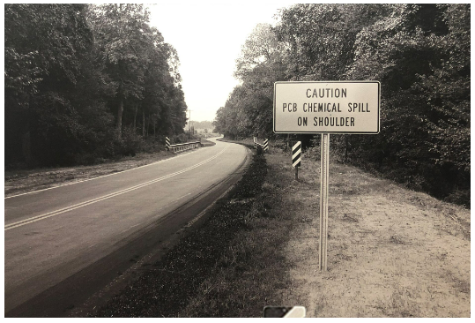
History of the EJ Movement
Very long history of environmental injustice and organized opposition. Inflection point with protests against the siting of a PCB landfill in Warren County.
A contractor hired by the Ward Transformer company illegally sprayed 13,000 gallons of PCB waste on 243 miles of roads at 51 sites in North Carolina in 1978.
Figure: 40,000 cubic yards of soil was contaminated in 14 North Carolina counties. (Image source, content source).
Notes:
Check out the link and scroll to the bottom. There’s a timeline of significant EJ moments in US history.
The contractor only received 1 year of prison time.

Slide 5
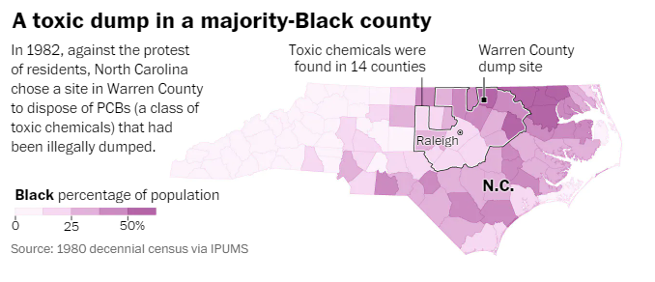
History of the EJ Movement
Chatham County
After considering 90 potential landfill sites, NC narrowed down to two locations:
Public landfill in Chatham County (26% Black, 7% below FPL).
Already a landfill. Clay-lined.
Privately-owned land on recently foreclosed property in Warren County (60% Black, 25% below FPL).
No city council or mayor
Shallow groundwater and permeable soils
Figure: Locations of the chemical spills and Warren county dump site (source).
Notes:
At the time, Warren County had the highest percentage of Black residents of any county in NC.

Slide 6
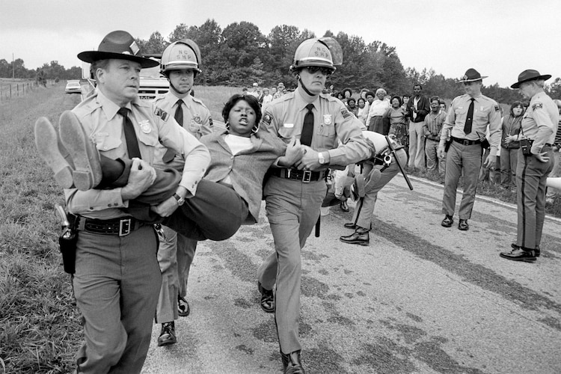
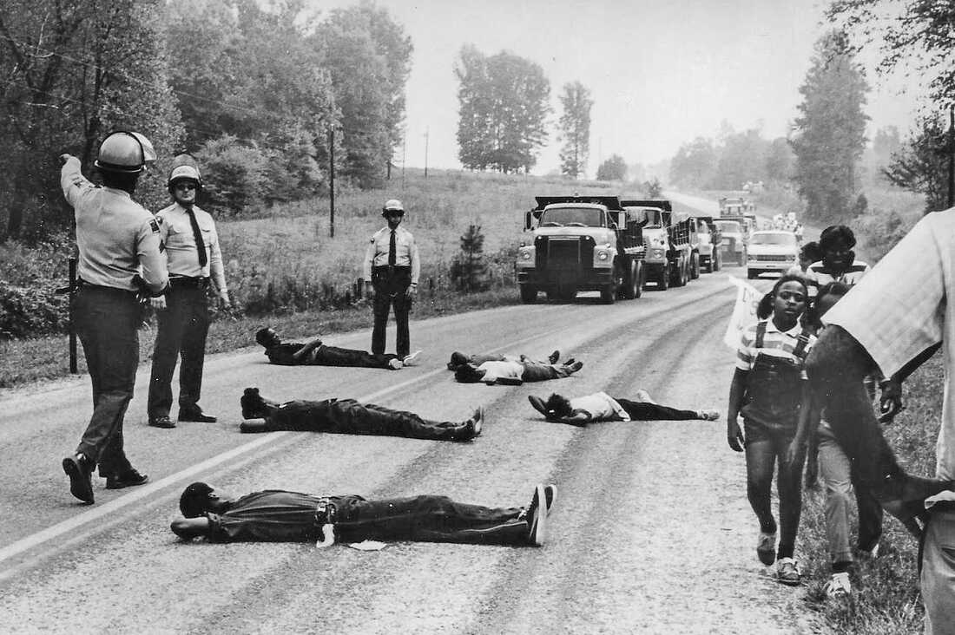
History of the EJ Movement
Figures: Protesters attempting to block delivery of PCB waste to the Warren County, NC landfill in 1982 (left image source and right image source).
Notes:
NC chose the Warren site. Multiple lawsuits, including by the NAACP, did not prevent the landfill creation moving forward.
In 1982, as trucks began to fill the Warren landfill with PCB wastes, local groups protested. 500 people were arrested, including Walter Fauntroy of the US House of Representatives and a leader of the United Church of Christ.
Landfill went ahead as planned.

Slide 7
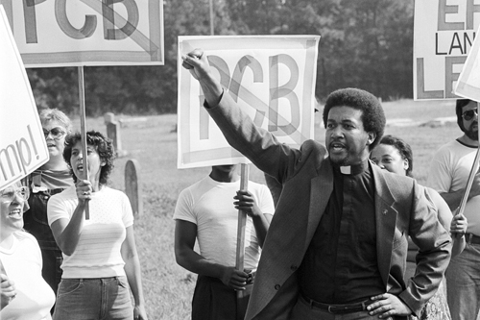
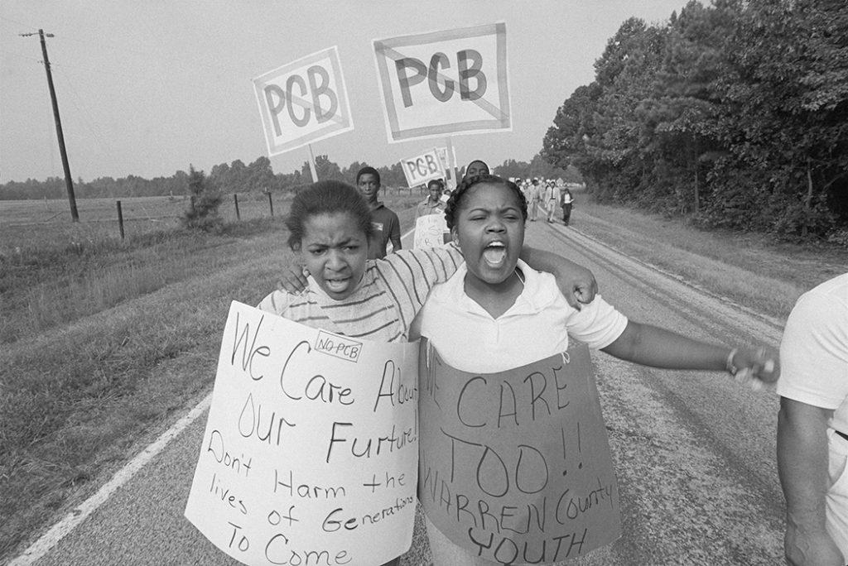
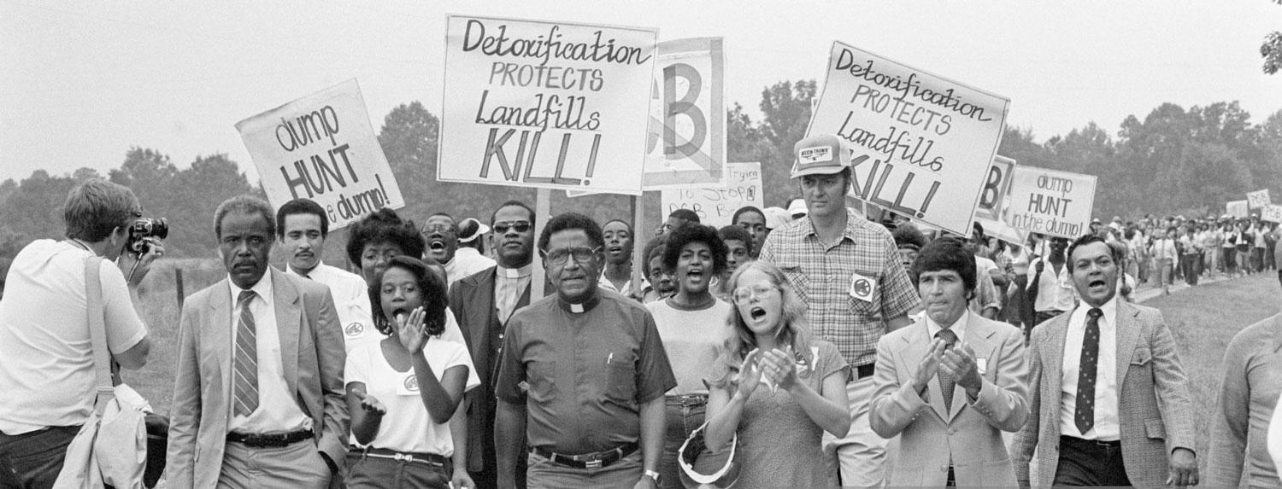
A Movement is Born
Image: Rev. Ben Chavis, a leader of UCC and the Commission for Racial Justice (CRJ). Coiner of the term “environmental racism.” (Source)
Image source: UNC library.
Image source.

Slide 8
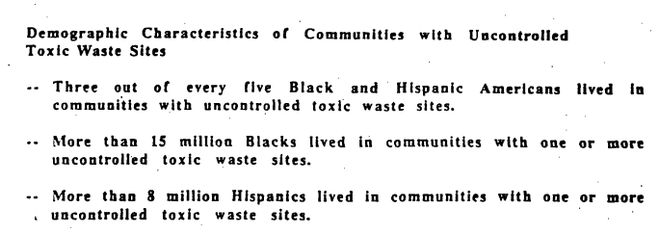
History of the EJ Movement
Two landmark studies followed:
Siting of Hazardous Waste Landfills and their Correlation with Racial and Economic Status of Surrounding Communities by the General Accounting Office (1983)
Toxic Wastes and Race by the Commission for Racial Justice of the United Church of Christ (1987).

Slide 9
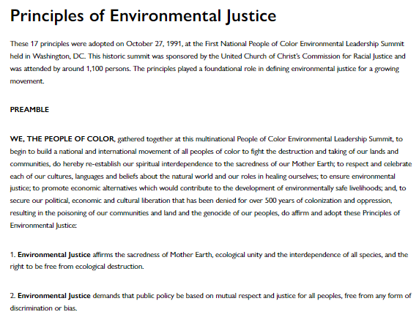
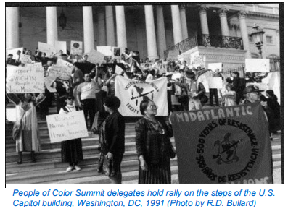
A Broad Coalition
In 1991, the UCC’s Commission for Racial Justice held the First National People of Color Environmental Leadership Summit.
The 17 Principles of Environmental Justice.

Slide 10
The Movement Gains Support
Executive Order 12898 signed in 1994.
Directs all federal agencies to identify and address disproportionately high and adverse effects of their policies on minority and low-income populations.
Bill Clinton signing EO 12898 (source).

Slide 11

Office of Environmental Justice Definition
The fair treatment and meaningful involvement of all people regardless of race, color, national origin, or income with respect to the development, implementation, and enforcement of environmental laws, regulations, and policies.
Fair treatment means no group of people should bear a disproportionate share of the negative environmental consequences resulting from industrial, governmental and commercial operations or policies.
-­‐ U.S. Environmental Protection Agency

Slide 12
Office of Environmental Justice Definition
The fair treatment and meaningful involvement of all people regardless of race, color, national origin, or income with respect to the development, implementation, and enforcement of environmental laws, regulations, and policies.
Fair treatment means no group of people should bear a disproportionate share of the negative environmental consequences resulting from industrial, governmental and commercial operations or policies.
-­‐ U.S. Environmental Protection Agency
Procedural
Justice
Distributive
Justice

Slide 13
Many studies established correlation between differential potential exposure and presence of low-income and minority populations.
Follow-up to Toxic Wastes and Race showed EJ concerns still prevalent.
Link to the full report.

Slide 14
Link to the full report, which includes another timeline of EJ milestones.

Slide 15
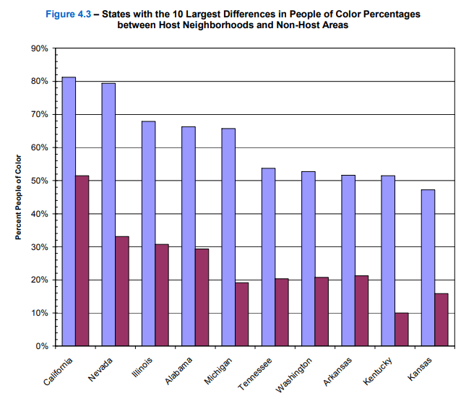
Link to the full report.

Slide 16
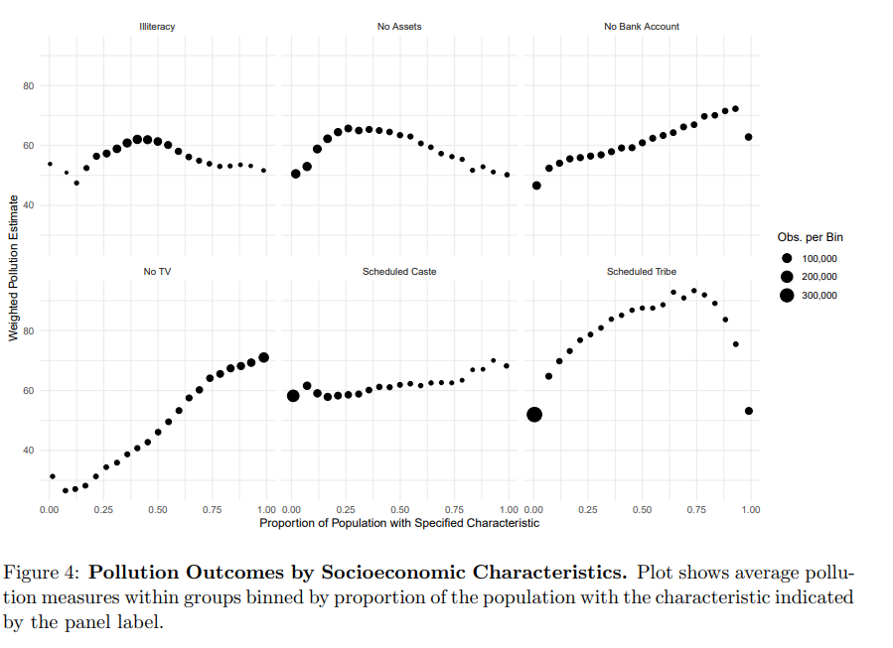
EJ Internationally
Differential exposure to nuisance pollution has been established as a stylized fact across many pollutant types, EJ groups of concern, and localities.
EJ concerns have been studied in many other contexts including India (Kopas et al., 2020), Italy (Germani et al., 2014), and New Zealand (Pearce et al., 2006).

Slide 17
Part 2: Sources of Environmental Inequality

Slide 18
Possible Explanations
Many non-exclusive sources of environmental justice concerns:
Disproportionate siting by firms
Coming to or fleeing pollution by households
Market coordination of firms and households
Discriminatory policies and/or enforcement
Intergenerational transmission

Slide 19
1. Disproportionate Siting
Some possible explanations for differential siting behavior of polluting firms in neighborhoods of lower income and/or with more people of color.
Internal Colonialism
Discriminatory siting behavior
Firms select locations based on local economic conditions such as inexpensive land, low-wage labor, or transportation networks.
Government permitting decisions may steer firms to certain regions

Slide 20

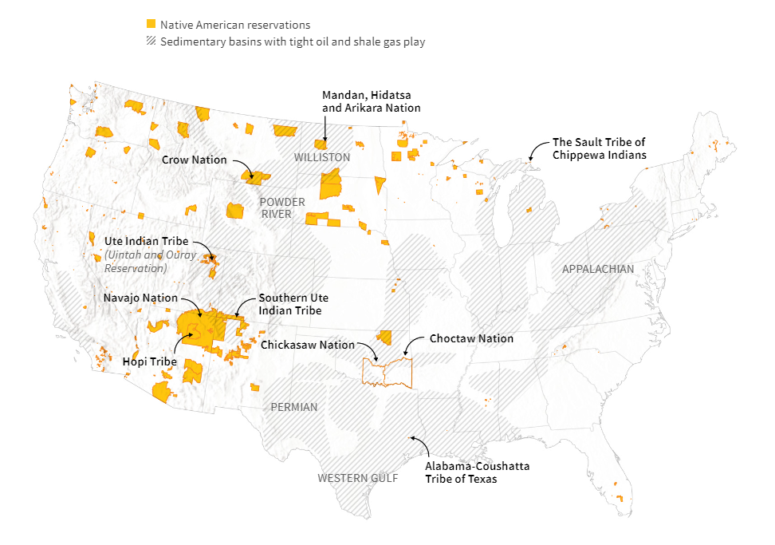
Internal Colonialism
Tribal reservations are 2% of US land but have:
30% of coal west of the Mississippi
50% of all uranium
20% of oil and shale natural gas
Source: Reuters (2017).

Slide 21
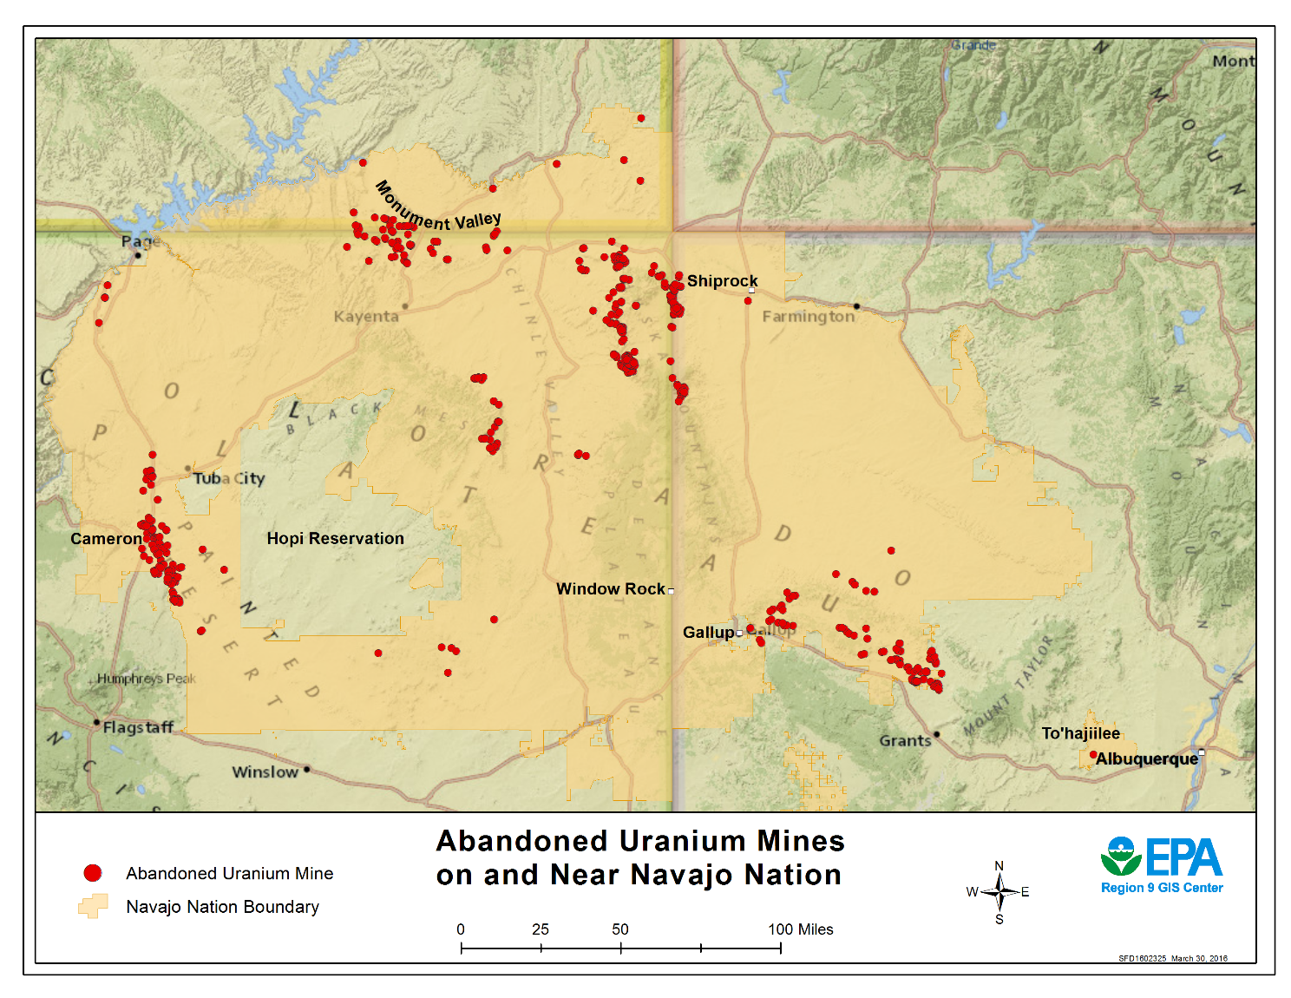
Internal Colonialism
Ongoing concerns, but legacy pollution from extraction is still relevant.
Uranium extraction on Navajo nation alone left over 1,000 abandoned uranium mines.
Spent nuclear fuel and weapons testing near Skull Valley Goshute reservation.
Source: EPA (2016).

Slide 22
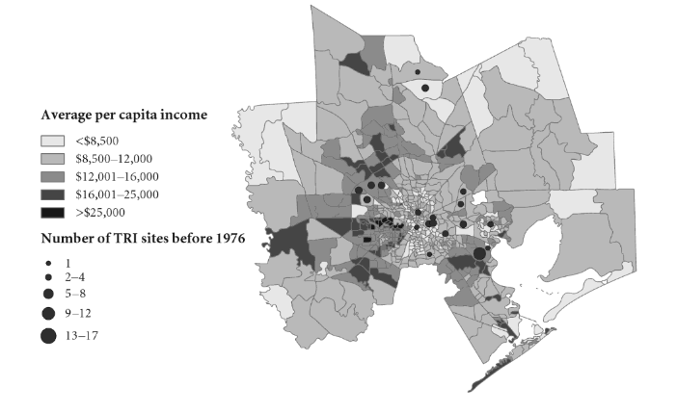
Wolverton (2009)
Research Questions:
Are correlations between firm location decisions and demographics robust to using demographics at the time of siting?
How do local economic conditions affect firm siting decisions?
Methods: Predict location of TRI sites in Houston and Dallas census tracts given demographic characteristics near the facility at the time the facility was sited.
Source: The Political Economy of Environmental Justice (2012)

Slide 23
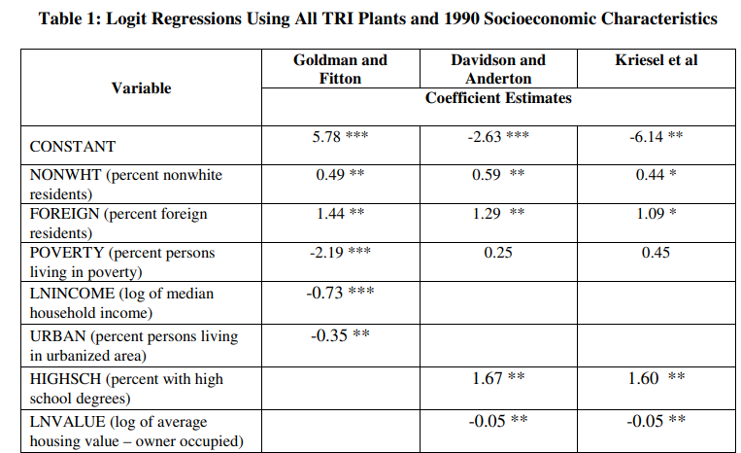
Wolverton (2009)
Findings:
1) TRI site location is strongly correlated with current demographics.

Slide 24
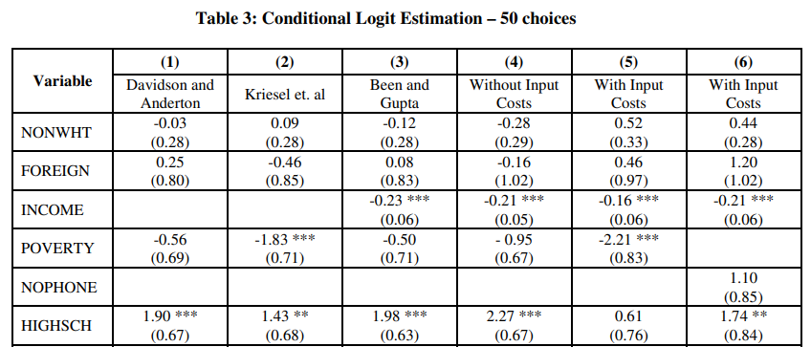
Wolverton (2009)
Findings:
2) TRI site location not significantly correlated with % non-white at the time of siting.
Still negatively correlated with income.

Slide 25
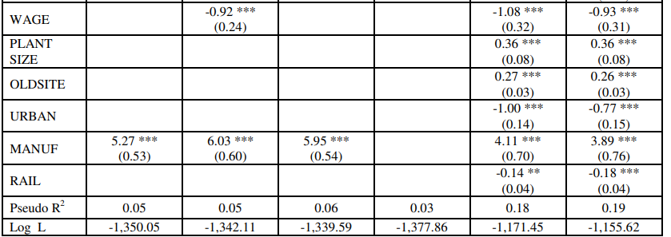
Wolverton (2009)
Findings:
3) TRI site location strongly predicted by local economic characteristics such as wages, distance to railroad, manufacturing share of the local workforce, and pre-existing TRI sites.

Slide 26
2. Coming to or Fleeing the Nuisance
Tiebout sorting: Households move based on their willingness and ability to pay for local amenities including environmental quality.
Households “vote with their feet” for neighborhood characteristics.
Stratification of amenity provision across income levels.
Areas with more amenities are more expensive, hence pricing lower income individuals out of the community.
Areas with worse pollution are cheaper, hence attracting lower-income renters.

Slide 27
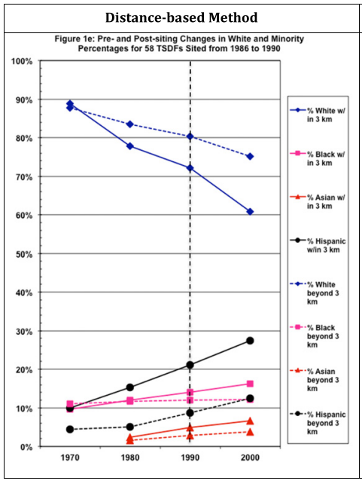
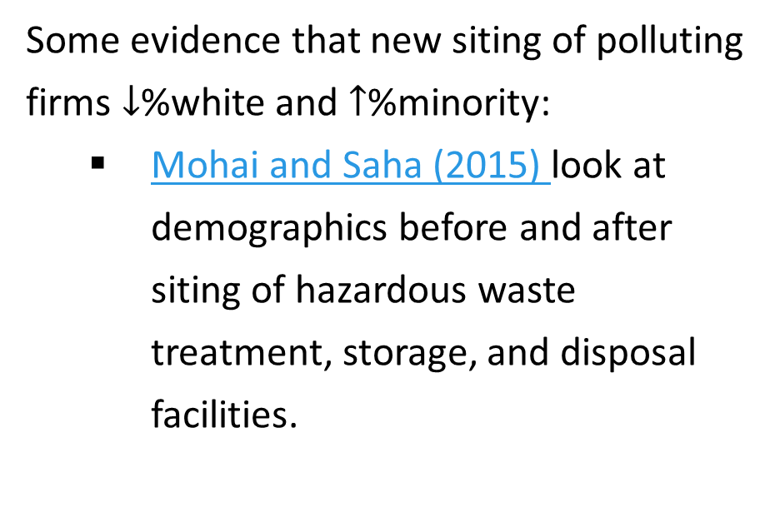
Evidence for Tiebout Sorting
Some evidence that new siting of polluting firms $↓$%white and $↑$%minority:
Mohai and Saha (2015) look at demographics before and after siting of hazardous waste treatment, storage, and disposal facilities.

Slide 28
More Evidence for Tiebout Sorting
Effects to changes in local pollution:
Banzhaf and Walsh (2007): changes in the emissions of toxic air pollutants in California associated with emigration of high-income households and immigration of low-income households.
Gamper-Rabindran and Timmins (2011) offer further evidence on the effect of Superfund site cleanups.

Slide 29
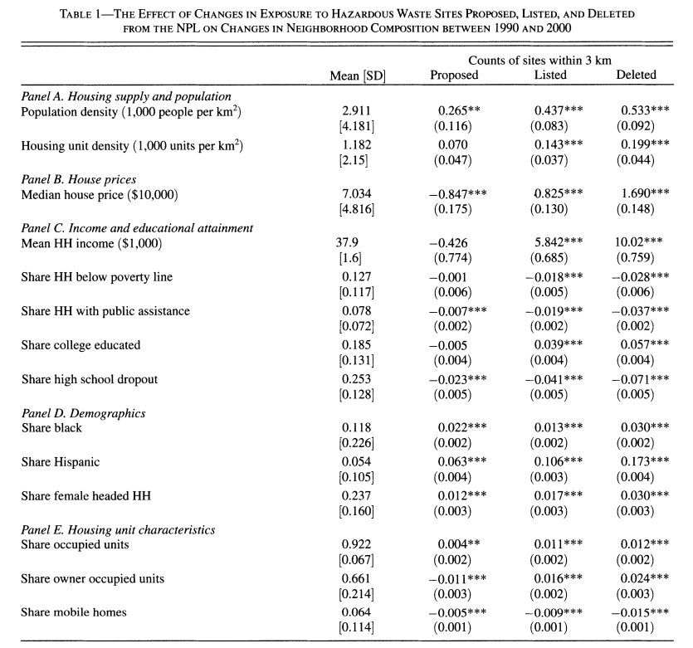
Gamper-Rabindran and Timmins (2011)
Using restricted-use census data that allows summarizing characteristics of households before and after cleanup.
More owner occupied.
Higher income and college educated.
Greater housing density.

Slide 30
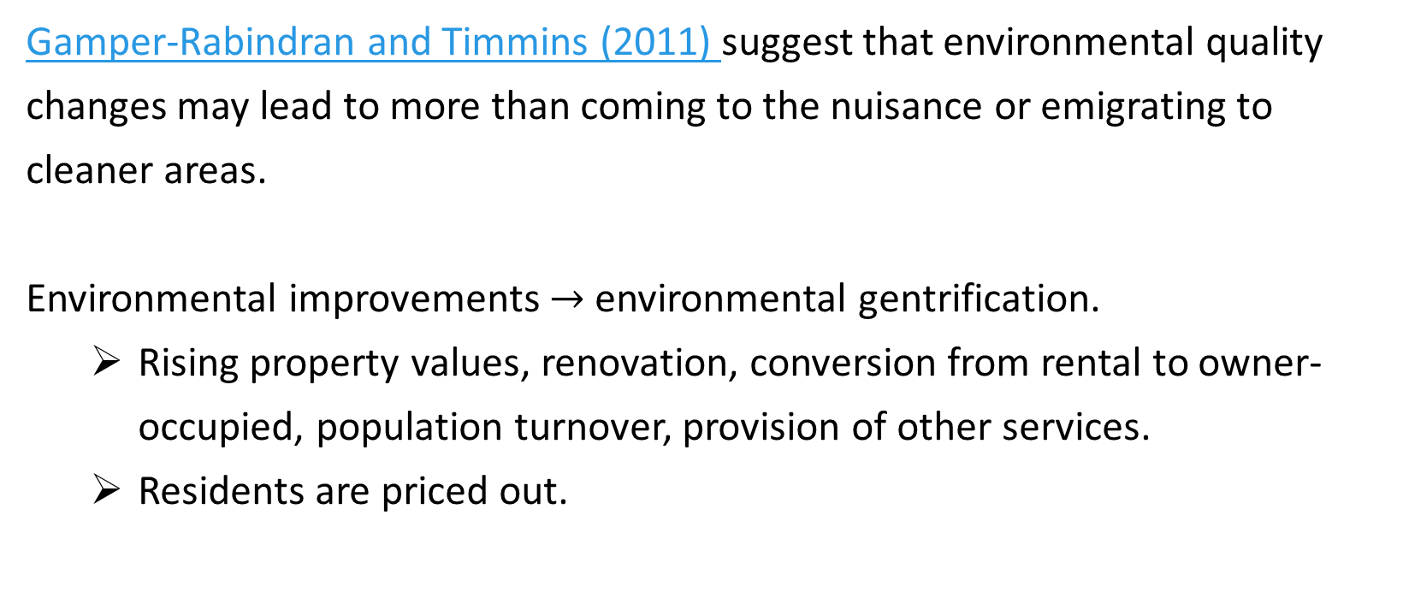
Environmental Gentrification
Gamper-Rabindran and Timmins (2011) suggest that environmental quality changes may lead to more than coming to the nuisance or emigrating to cleaner areas.
Environmental improvements $→$ environmental gentrification.
Rising property values, renovation, conversion from rental to owner-occupied, population turnover, provision of other services.
Residents are priced out.

Slide 31
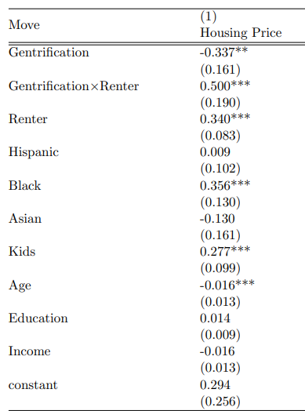
Environmental Gentrification
Qiang, Timmins, and Wang (2021) study LA using the Family and Neighborhood Survey.
Probit model: how do housing value increases in LA >10% from 2000-2006 increase the likelihood of out-migration by renters?

Slide 32
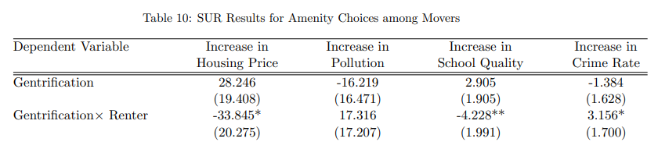
Environmental Gentrification
Qiang, Timmins, and Wang (2021) also show where displaced renters move.

Slide 33
Tiebout Sorting
Housing sorting behavior:
Evidence for coming to the nuisance and fleeing the nuisance.
Cleanup has been linked to environmental gentrification.
Welfare implications for EJ communities?
Less pollution is a welfare improvement, but could be negated if low-income households are priced out and move to more polluted regions.
Contextual factors complicate efficiency considerations of sorting. Hysteresis, steering, housing discrimination, etc.

Slide 34
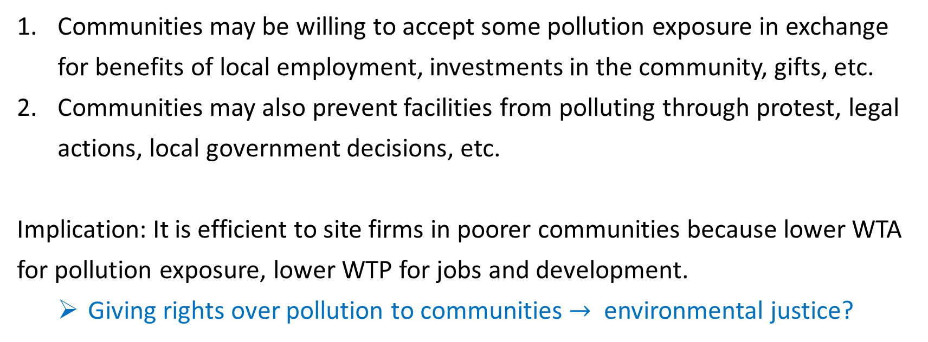
3. Coasean Bargaining
Communities may be willing to accept some pollution exposure in exchange for benefits of local employment, investments in the community, gifts, etc.
Communities may also prevent facilities from polluting through protest, legal actions, local government decisions, etc.
Implication: It is efficient to site firms in poorer communities because lower WTA for pollution exposure, lower WTP for jobs and development.
Giving rights over pollution to communities $→$ environmental justice?

Slide 35
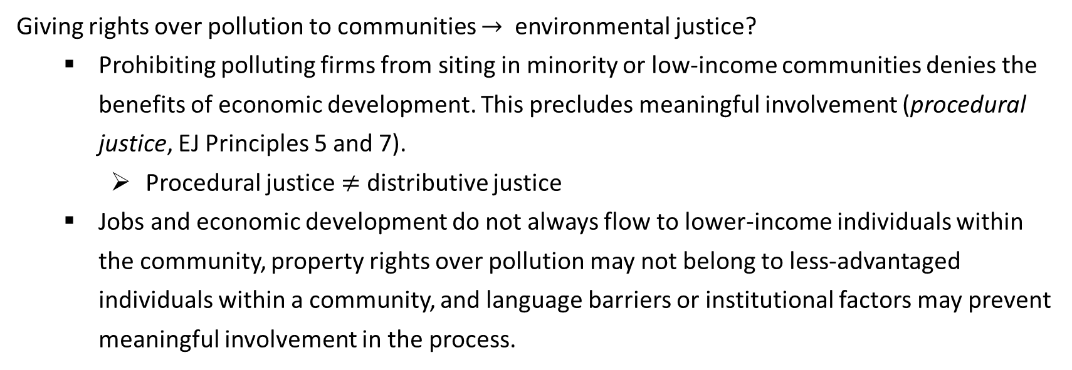
Two Sides of Coasean Bargaining
Giving rights over pollution to communities $→$ environmental justice?
Prohibiting polluting firms from siting in minority or low-income communities denies the benefits of economic development. This precludes meaningful involvement (procedural justice, EJ Principles 5 and 7).
Procedural justice $≠$ distributive justice
Jobs and economic development do not always flow to lower-income individuals within the community, property rights over pollution may not belong to less-advantaged individuals within a community, and language barriers or institutional factors may prevent meaningful involvement in the process.
Notes:
Cerrell Associates 1984: hazardous waste facilities targeted “local communities that would not protest the location of waste sites in their area—in particular, people without a college education, the poor, Catholics, and those “not involved in voluntary associations.”
See the whole Cerrell report:
http://www.voicesfromthevalley.org/wp-content/uploads/2011/10/cerrell_report.pdf

Slide 36
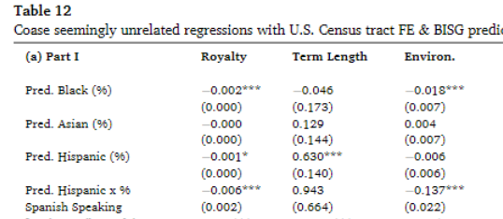
Evidence from Fracking Lease Negotiations
Timmins and Vessing (2022) ask how private lease negotiations for hydraulic fracturing wells vary with measures of wealth, race, ethnicity, and language.
Failure to negotiate protections in leases leads to increased risk of drilling violations. Suggests a “breakdown of efficient Coasian bargaining.”
Notes:
Full quote: “If willingness-to-pay is indeed a function of race, ethnicity, and linguistic isolation after controlling for household attributes like income and education, this would suggest a breakdown of Coasian bargaining, driven largely by information asymmetry.”

Slide 37
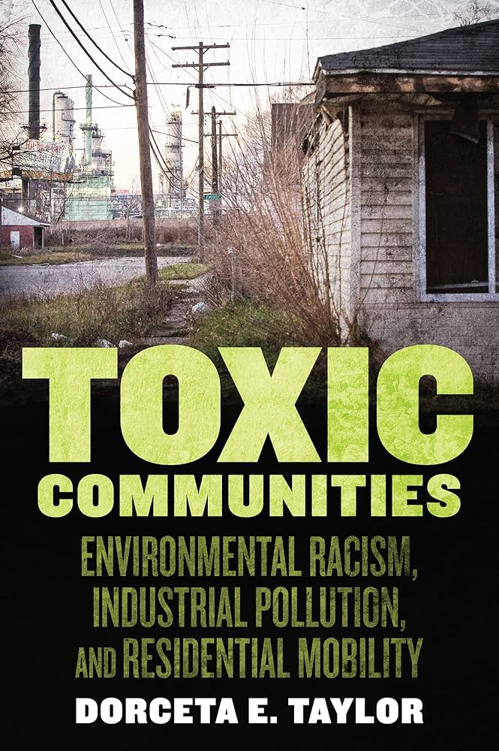
4. Discriminatory Policies and Enforcement
Previously covered some examples in class:
Steering behaviors and discrimination in the housing market.
More examples:
Zoning practices
Housing covenants
Expulsive urban renewal
Longer time to return to compliance in SDWA violations (will cover in module 4)
Recommended reading to learn more.

Slide 38
Discriminatory Zoning
Zoning practices are rules on the use of land. They establish parking lot requirements, building heights, housing types, etc.
Zoning rules define where polluting facilities can legally operate.
In the US, zoning laws were also used to create and enforce housing segregation.
Redlining practices, encouraged by the Federal Housing Administration, were underwriting criteria for mortgages. Criteria were explicitly based on race and environmental hazards.

Slide 39
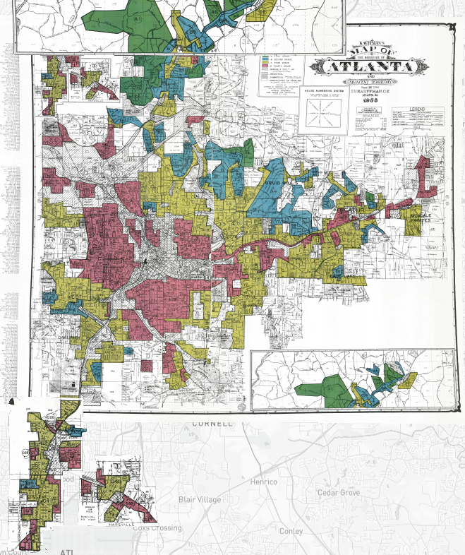
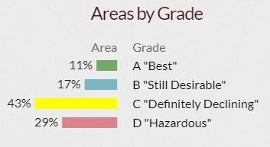
Redlining in Atlanta
Redlined areas often correspond to segregated zones with greater minority share and more pollution.
Minority neighborhoods pay a premium for access to credit or don’t receive it at all.
Less investment led to food deserts, lack of healthcare access, and disinvestment.
Contributed to the race wealth gap.
See “Mapping Inequality…” for other cities.

Slide 40
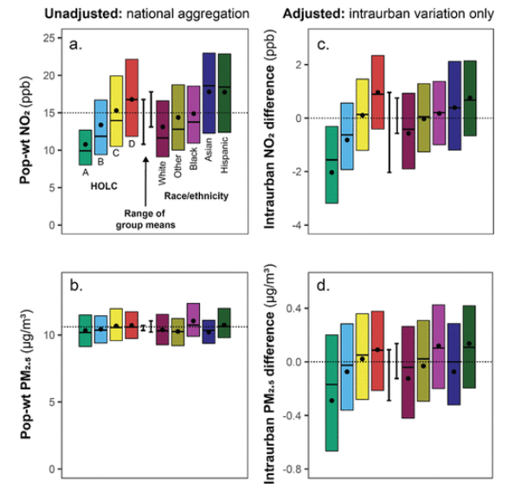
Effects of Redlining
Today
Redlining created persistent gaps in air pollution exposure that are still evident today.
Figure displays exposure differentials in 202 redlined cities with population of 45 million.
Source: Lane, Morello-Frosch, Marshall, Apte (2022).

Slide 41
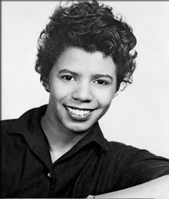

Housing Covenants
Housing covenants were house- or neighborhood-level agreements not to sell homes to specific minority groups.
Limited potential for people of color to flee the nuisance to newer homes constructed away from industrial zones.
Lorraine Hansberry and George Bush’s experiences with racial housing covenants.

Slide 42
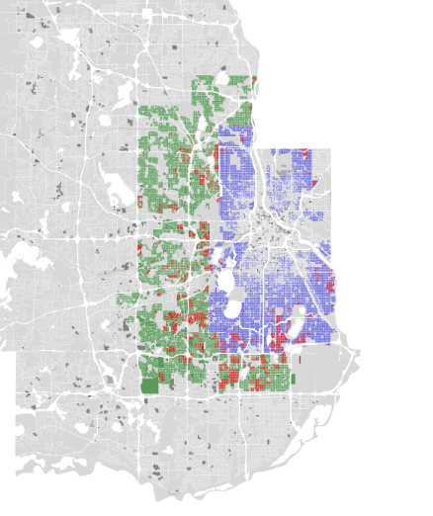
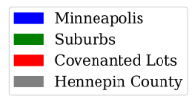
Long-term Impact
Using 120,000 properties in Minnesota, Sood et al. (2021) find that:
Covenanted houses in 1948 have 3.4% higher present values.
Census blocks with 1% increase in covenanted homes in a census block reduces current % Black by 14% and Black homeownership by 19%.

Slide 43
Expulsive Urban Renewal
Eminent domain takes private property for public use in exchange for just compensation.
Eminent domain, urban renewal, and urban planning differentially target properties inhabited by people of color.
Of 2,500 cases of eminent domain in 992 cities from 1949 to 1973, one million people were displaced and two thirds were Black (Fullilove, 2015).
In combination with zoning, redlining, housing covenants, and hysteresis, limits options for escaping pollution.

Slide 44
5. Intergenerational Transmission
Health, Education, Income
The fetal origins hypothesis suggests that pollution exposure in utero has lifelong effects on physical health, educational attainment, and income.
Almond and Currie, “Killing me Softly: The Fetal Origins Hypothesis” (2011) overview.
Follow-up in 2018 with more evidence.
Fetal Environmental Health
Tiebout Sorting
Pollution Exposure

Slide 45
Concluding Remarks
From an economics and EJ perspective, important to disentangle causes to determine policy implications, but often current causes are not easily separable from past causes.
Even with good causal inference, equity/efficiency trade-offs often remain:
Differential sorting might imply economic efficiency if equal access and no discrimination.
Environmental gentrification, red-lining, housing covenants, steering, and hysteresis.
Differential siting might imply economic efficiency if meaningful community involvement and fair negotiations.
Internal colonialism, firm enticement and manipulation, bargaining power, and coordination problem.

Slide 46
Next class
No class on Monday, October 9th.
Next Wednesday we will cover how to conduct an EJ analysis and walk through some examples. I will post your case study assignment in the next few days.
Readings for Wednesday:
Andarge et al. (2023)
(optional) EJ Technical Guidance Ch. 2-4

